Slide 1

Peer-graded Assignment: Final Projects NYPD Shooting Incident Data: Review and Data Analysis
Tung Anh nguyen sy
2023/03/17

Slide 2
NYPD Shooting Incident Data
Everything including this very own video presentation as well as the corresponding R code can be accessed at my GitHub repository:
https://github.com/tanh3ka/Master-of-Science-in-Data-Science-5301

Slide 3
Main objectives
GOAL:
Import the dataset
Examine the data
Clean the data
- Visual analysis
- Model
- Statistical Analysis
Establish a relevant question
Notes:
STARTED – SIMPLE OBJECTIVE: DATA SET - REVIEW – FORUMULATE
HOW DATA REVIEWED / CLEAED
QUESTION: VARIATION IN NUMBER SHOOTING BY BOROUGH
VISUAL ANALYSIS → MODELING AND STATISTICAL ANALYSIS TO CONFIRM

Slide 4
Dataset
Sourced from a public repository.
URL: https://data.cityofnewyork.us/Public-Safety/NYPD-Shooting-Incident-Data-Historic-/833y-fsy8
Gathered by the New York Police Department.
Spanning from 2006 to 2021.
13 variables within the dataset pertaining to each incident.
Total of 25,600 cases or incidents of distinct shooting occurrences.
Notes:
- FROM PUBLIC REPOSITORY – AVAILABLE TO ALL
- COMPILED BY NYPD – FROM REPORTED INCIDENTS - EXTRACTED QUARTERLY, REVIWEED BY OFFICE OF MANAGEMENT ANALYSIS AND PLANNING
- 15 YEAR PERIOD 2006 – 2021
- VARIABLES: DATE/TIME, LOCAITON / BOROUGH / PRECINCT / GEOSPATIAL DATA; SUSPECT / VICTIM DEMOGRAPHIC/RACIAL DATA
- INCIDENT = RECORD - OVER 25K FOR REVIEW

Slide 5
Clean and prepare the dataset
Review the dataset and its values.
Remove unwanted variables from the dataset.
Convert to keep the variable classes’ consistency.
Detect invalid values.
Encode missing values.
Notes:
- REVIEW: WHAT VARIABLES, HOW CODED (class, type), ANOMALIES (coding, bad values)
- REMOVING UNWANTED VARIABLE
- RECODING: VARIABLE CLASSES (factor / date) – EASIER TO HANDLE IN R
- IDENTIFY BAD VALUES (bad age values) - don’t foul analysis
- UNIFORM CODING MISSING VALUES
- EXPLORATORY DATA ANALYSIS

Slide 6
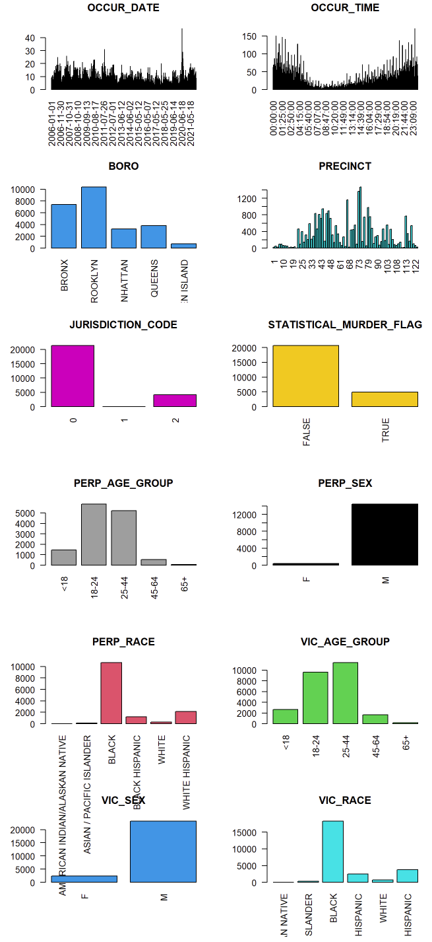
EDA exploratory data analysis
Notes:
EXPLORATORY DATA ANALYSIS → QUESTION OF INTEREST
VARIATION BETWEEN DIFFERENT BUROUGHS
NORMALIZED DATA – CENSUS BEAREAU DATA FOR POPULATION TO NORMALIZE TO PER CAPITA RATES
BRONX / BROOKLYN

Slide 7
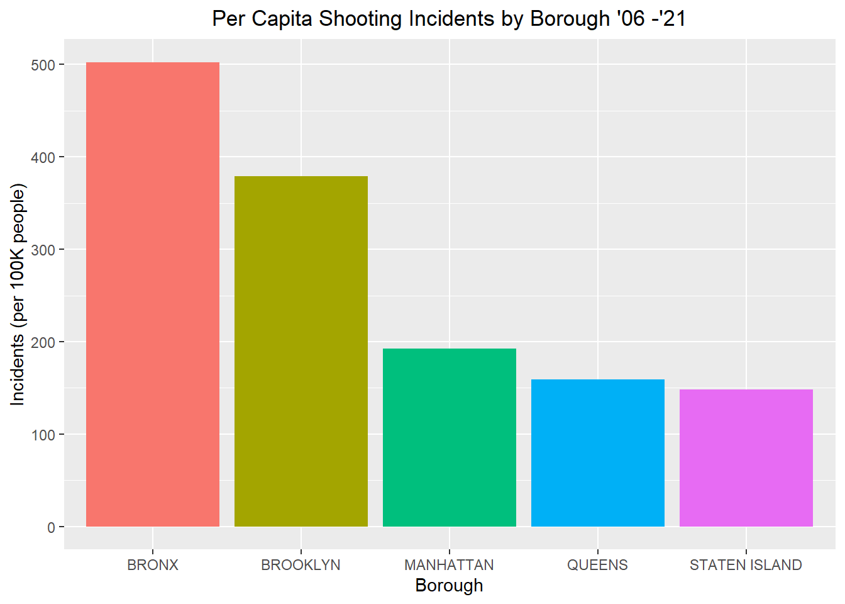
ANALYSIS
Notes:
- REVIEW: WHAT VARIABLES, HOW CODED (class, type), ANOMALIES (coding, bad values)
- REMOVING UNWANTED VARIABLE
- RECODING: VARIABLE CLASSES (factor / date) – EASIER TO HANDLE IN R
- IDENTIFY BAD VALUES (bad age values) - don’t foul analysis
- UNIFORM CODING MISSING VALUES
- EXPLORATORY DATA ANALYSIS

Slide 8
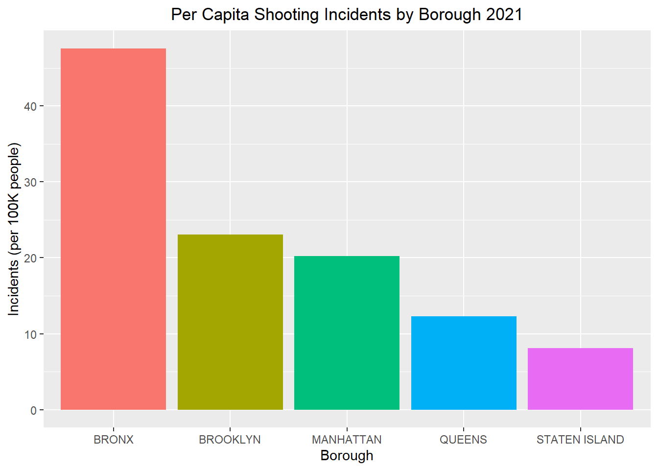
ANALYSIS
Notes:
- REVIEW: WHAT VARIABLES, HOW CODED (class, type), ANOMALIES (coding, bad values)
- REMOVING UNWANTED VARIABLE
- RECODING: VARIABLE CLASSES (factor / date) – EASIER TO HANDLE IN R
- IDENTIFY BAD VALUES (bad age values) - don’t foul analysis
- UNIFORM CODING MISSING VALUES
- EXPLORATORY DATA ANALYSIS

Slide 9
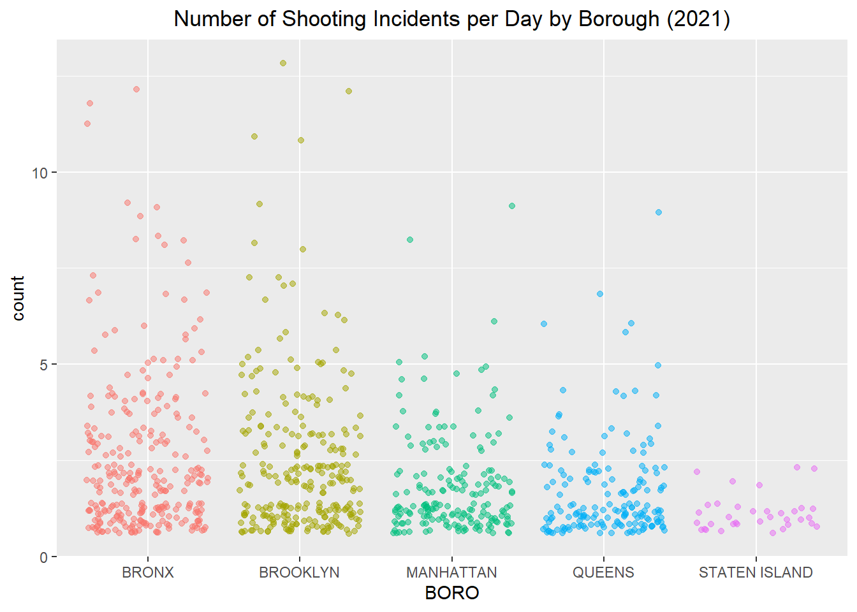
ANALYSIS
Notes:
- REVIEW: WHAT VARIABLES, HOW CODED (class, type), ANOMALIES (coding, bad values)
- REMOVING UNWANTED VARIABLE
- RECODING: VARIABLE CLASSES (factor / date) – EASIER TO HANDLE IN R
- IDENTIFY BAD VALUES (bad age values) - don’t foul analysis
- UNIFORM CODING MISSING VALUES
- EXPLORATORY DATA ANALYSIS

Slide 10
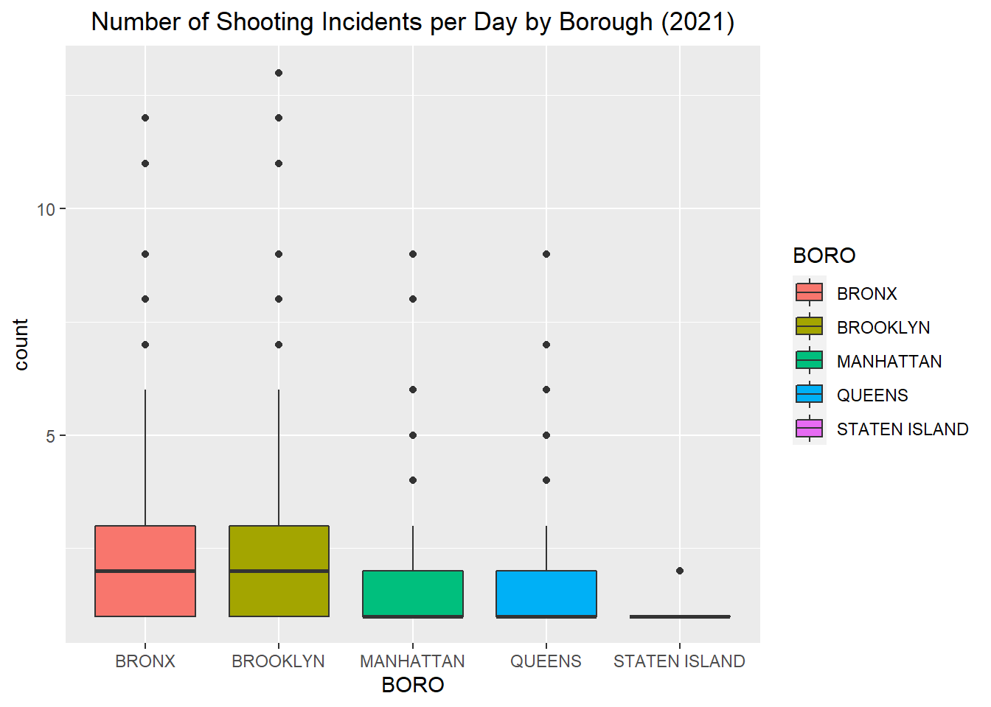
ANALYSIS
Notes:
- REVIEW: WHAT VARIABLES, HOW CODED (class, type), ANOMALIES (coding, bad values)
- REMOVING UNWANTED VARIABLE
- RECODING: VARIABLE CLASSES (factor / date) – EASIER TO HANDLE IN R
- IDENTIFY BAD VALUES (bad age values) - don’t foul analysis
- UNIFORM CODING MISSING VALUES
- EXPLORATORY DATA ANALYSIS

Slide 11
Model Building and Statistical Analysis
Model Building: construct a generalized linear model.
Poisson Response: the count of incidents per day.
Borough: the independent variable.
Valid Test: chi-squared test on the residual deviants and degrees of freedom.
Conclusion: a difference does exist among the various groups.
Notes:
IN ORDER TO TEST DIFFERENCES
GLM CONSTRUCTIED – COUNT INC/DAY AS POISSON RESPONSE – ON BOROOUGH AS INDEPENDENT VARIABLE
TESTING OF MODEL ON RESIDUAL DEVIANCE AND d.f USING CHI SQUARED TEST – MODEL VALID (# SHOOTINGS / DAY RELATED TO BOROUGH)
ANOVA TESTING CONFIRMS – DIFFERENCE EXITS
FURTHER TESTING DETERMINE WHAT DIFFERENCE – ESTIMATED MARGINAL MEANS PACKAGE with BONFERRONI CORRECTION

Slide 12
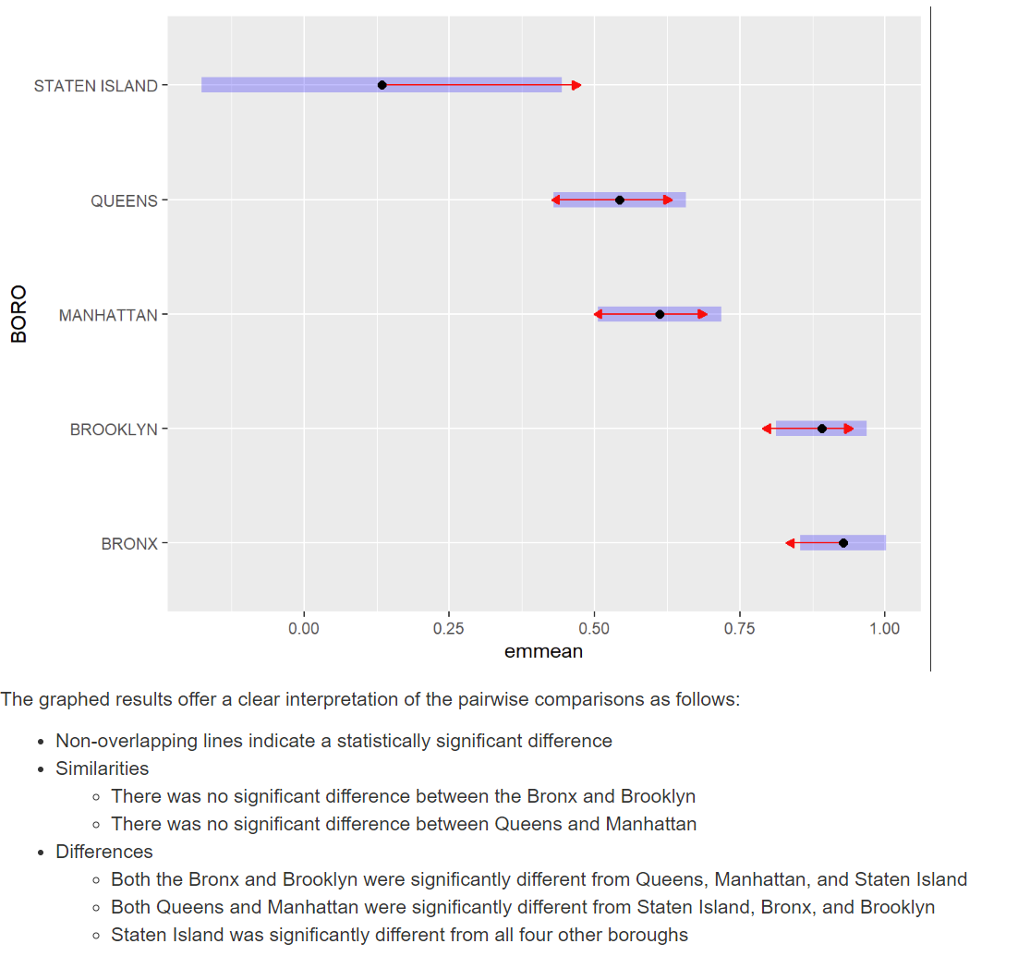
Model Building and Statistical Analysis
Notes:
IN ORDER TO TEST DIFFERENCES
GLM CONSTRUCTIED – COUNT INC/DAY AS POISSON RESPONSE – ON BOROOUGH AS INDEPENDENT VARIABLE
TESTING OF MODEL ON RESIDUAL DEVIANCE AND d.f USING CHI SQUARED TEST – MODEL VALID (# SHOOTINGS / DAY RELATED TO BOROUGH)
ANOVA TESTING CONFIRMS – DIFFERENCE EXITS
FURTHER TESTING DETERMINE WHAT DIFFERENCE – ESTIMATED MARGINAL MEANS PACKAGE with BONFERRONI CORRECTION

Slide 13
Bias and Criticisms
Data collection may be subject to underreporting.
The actual number of incidents may differ from those reported.
Inherent bias may be present in data collection.
Interpretation of the results should be approached with caution.
Recommendations based on this or other analyses must be carefully considered.
Conclusion:
Disparities exist, and further analysis and discussion should be pursued to understand the underlying causes and potential solutions to decrease these disparities.
Through a disciplined approach utilizing data science and statistical analysis, we can hopefully gain more information and insights to reduce future incidents.
Notes:
MOVING FORWARD – CHANGES TO REDUCE # SHOOTINGS
POTENTIAL ISSUES w DATA COLLECTION
ACTUAL != REPORTED – MAY BE ISSUES W UNDER-REPORTING
(NO INJURY, POLICE AVAILABILITY / RECEPTABILITY / RESPONSE, FEAR OF RECRIMINATION, COMMUNITY BELIEFS / PERCEPTIONS)
POSS INHERENT BIAS IN DATA COLLECTION – eg RACIAL DATA MAY SUGGEST PRE-CONCEIVED NOTION
CAUTION W INTERPRETATION – RESULTS ARE VIEWED IN PERSONAL CONTEXT (MAYOR, POLICE CHIEF, RESIDENT, TOURIST, SOCIAL WORKER, PASTOR, CRIMINAL)
RECOMMENDATIONS
- DISPARITY EXISTS – SOCIAL / POLITICAL SIGNIFICANCE
DISCIPLINED APPROACH – HELP UNDERSTAND UNDERLYING CAUSES
FURTHER ANALYSIS AND MORE INFORMATION

Slide 14
Thank you for watching!
My GitHub repository: https://github.com/tanh3ka/Master-of-Science-in-Data-Science-5301
Data source:
https://data.cityofnewyork.us/Public-Safety/NYPD-Shooting-Incident-Data-Historic-/833y-fsy8

